Slide 1

DOMAIN 3in ISC2
(access control concepts)
BY
EZEKWE KING DAVID NNAEMEKA

Slide 2
scope
The layered strategy: Overview of security controls, including security control concepts, defense in depth, and privileged account access management.
Administrative guardrails: Separation of duties, covering two-person integrity, authorized versus unauthorized accounts, user provisioning processes, and separation of employment.
Physical security controls, including types of physical access control, badge systems, CPTED, biometric controls, monitoring, security guards, and alarm systems.
Logical access control.
Access control models,DAC,MAC, RBAC and RuBAC.
Conclusion and Q&A.

Slide 3
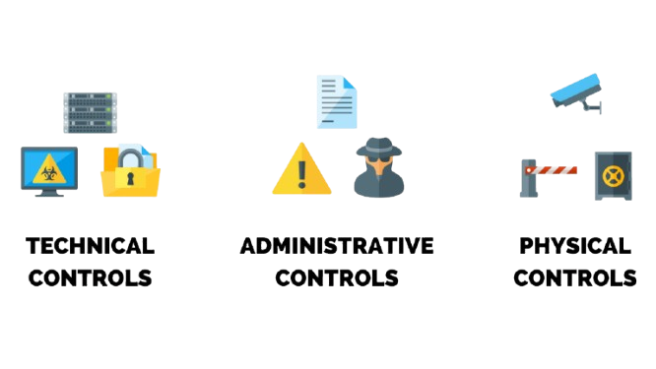
The Layered Strategy
Security Control Concepts: High-level mechanisms to manage risk.
Privileged Accounts: Managing access for Admins, Help Desk, and Analysts

Slide 4
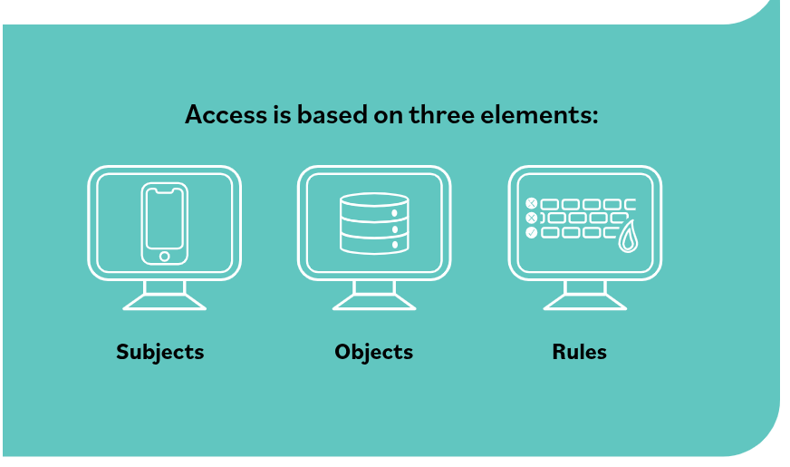
ACCESS CONTROL OVERVIEW

Slide 5
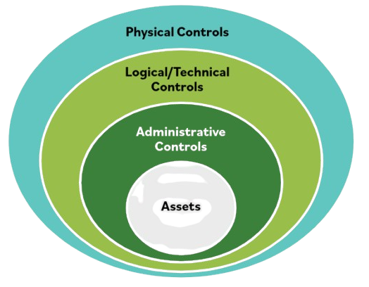
DEFENSE IN DEPTH

Slide 6
ADMINISTRATIVE GUARDRAILS
Separation of Duties: Dividing tasks to prevent fraud or error.
Two-Person Integrity: Requiring dual authorization for critical actions.
Employment Lifecycle: Formal processes for provisioning and separation.

Slide 7
Authorized personnel | Unauthorized personnel
Element | Authorized Personnel | Unauthorized Personnel
Subject | Validated entities (users/processes) with verified identities. | Entities that lack valid credentials or formal system recognition.
Object | Granted access to specific resources (files, databases, hardware). | Denied access to resources; the system blocks their interaction.
Rules | These individuals satisfy the logic or conditions (MAC, RBAC, etc.) required for access. | These individuals fail to meet the required criteria or security labels.

Slide 8
Physical Security
Environment: CPTED (Crime Prevention Through Environmental Design).
Detection: Integrated alarm systems and monitoring.
Verification: Badge systems, security guards, and biometric controls.

Slide 9
Logical access control element
Technical Control: Digital gatekeeping for system protection.
The Trinity: Access is determined by three fundamental components
Identification
Authentification
Authorization
(Subjects, Objects, and Rules):

Slide 10
Access Control Models
DAC & MAC: Discretionary (owner-based) vs. Mandatory (label-based).
RBAC & RuBAC: Role-based (job function) vs. Rule-based (conditional).
DAC | MAC
RBAC | RUBAC

Slide 11
CONCLUSION
Summary: Integration of Physical, Administrative, and Logical controls.

Slide 12
THANK YOU
Q&A

